Slide 1
Regression Testing
is typically characterized by
Ensuring a specified deployed environment performs and produces consistent results
Can be triggered manually or automatically by linking it with an event
Ideally could be executed many as many times as required - idempotent
Automatically sends out alerts in case of any failure or unexpected result
Communicated results can be used to pinpoint anomalies
Executes the entire range of functionality of the system under test (FR / NFR)

Slide 2
Regression Testing
is not
Unit testing
Coverage testing
Integration testing
Specific functionality (use case) testing
Testing or checking the health of a deployed environment

Slide 3
Regression Testing – Instance Life-Cycle
Trigger Event
Prepare Run
Execute Tests
Generate Results
Distribute Results
Cron Job Activation
Setup Run
Pre-Request Script
Destroy Simulator
Prepare Email
Validation
Simulator Container
Postman Request
Finalise Report
Attach Report
Pass?
Test Container
Test Assertions
Send Email
Log Result
Destroy Test Container
Test Pass?
Done?
Exit 1st Error?

Slide 4





Regression Testing Info-graphic
Mo
AWS EC2 [postman-test]
Simulator Container
Test Container
SMTP Server
Postman Repository
Report Template

Slide 5
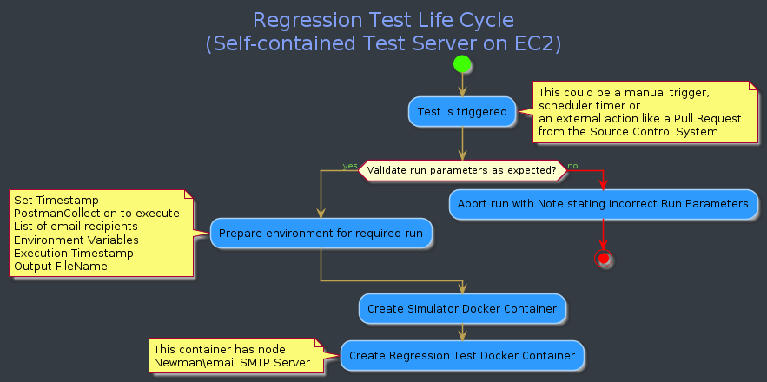
Regression Testing Process Flow – Part 1

Slide 6
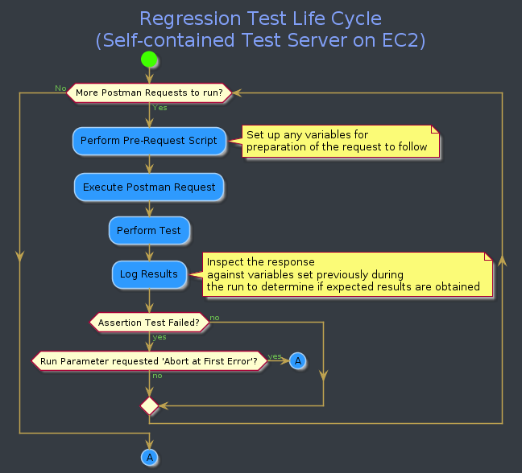
Regression Testing Process Flow – Part 2

Slide 7
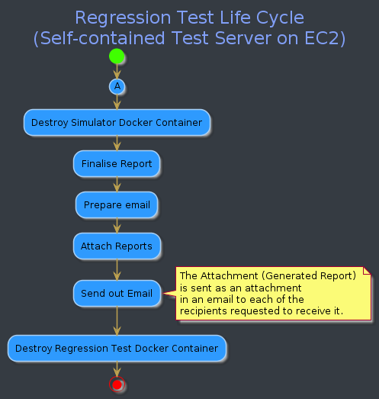
Regression Testing Process Flow – Part 3

